Slide 1
CS100 Introduction to Programming
Recitation 5

Slide 2
NO PLAGIARISM!!!
The most likely cause for failing this course.
You WILL be caught!
We WILL punish!
They WILL know!
Parents
University
School
Fellows

Slide 3
Overview
Memory Management
Linked List
(Introduction to OOP)

Slide 4
Memory Management

Slide 5
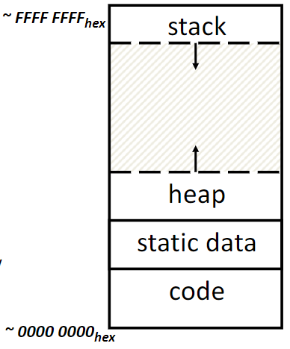
C Memory Management
4 regions of address space:
code
loaded when program starts, does not change
static data
variables declared outside functions(variables with “static”)
loaded when program starts, modifiable
heap
space reuested for dynamic data via malloc/calloc/realloc
grows upward
stack
local variables and function parameters inside functions
return address when recursion
grows downward
Assume 32bit here

Slide 6
Where are Variables Allocated
If declared outside a function, allocated in ‘static’ storage
If declared inside function (including main()) without ‘static’ keyword, allocated on the ‘stack’ and freed when function returns.
keyword ‘static’ make the variable acts as a global variable while its scope limited in current file or scope.
This website may help(For those who are interested in how compiler work)
In this case, count is initialized when program start, the statement “count = 10” will not actually execute during function call.
count is in ‘static’ but can not be access outside the function (unless access by address).
int Fun() {
static int count = 10;
return count--;
};

Slide 7
Linked List

Slide 8
Why linked list
Dynamically enlarge the size of list
Insert or remove elements in any position of list
Typical usage:
Heap Management (Introduced in CS110)
Hash Map (To solve hash conflict, Introduced in CS101)

Slide 9
Basic Structure
A linked list is a data structure where each object is stored in a node
As well as storing data, the node must also contains a pointer to the node containing the next item of data
Head pointer is used to store the address of first node
L
42
95
70
81
∅
typedef struct _node {
int value;
struct _node *next;
} Node;

Slide 10
Initialization and Traverse
To initialize an empty linked list, we may let the head point to NULL or allocate an empty node.
To traverse a linked list, we start from head and recursively access the node next to current node until meet NULL
Node *head = NULL;
Node *last = head;
if (last) {
while (last->next) {
// do something
last = last->next;
}
}

Slide 11

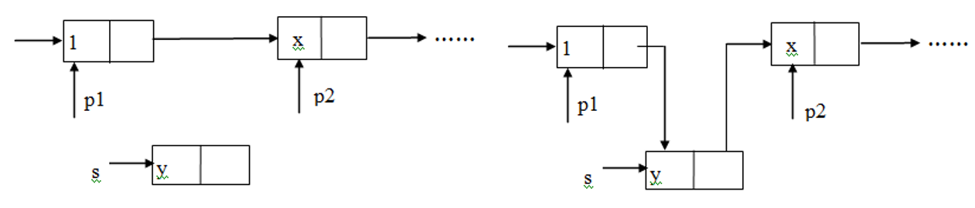
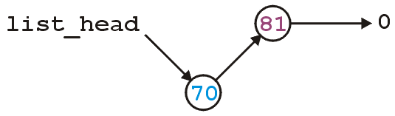
Insertion
If the linked list is originally empty
Allocate a new node and assign its address to head
If the new node is supposed to be inserted at front
Let the new node points to the original head
Assign the new node’s address to the head pointer
Else
Let the new node points to the node after it
Let the node before the new node points to it

Slide 12

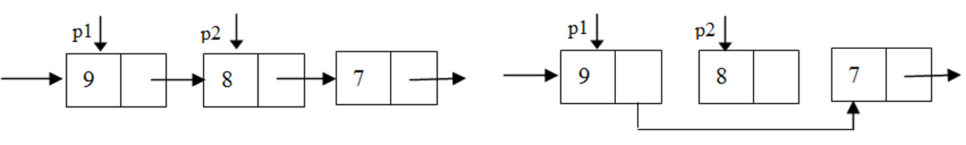
Pop front and erase
To pop the front node
Assign the address of next node to head
Free the original head
To erase node in other position
Let the node before it points to the node after it.
Free the target node

Slide 13
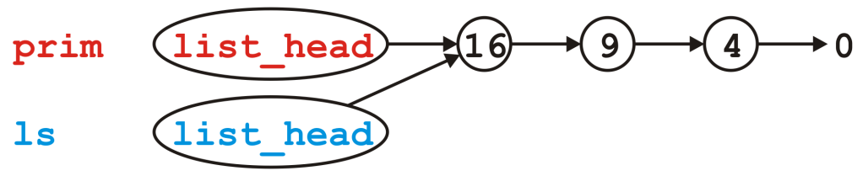
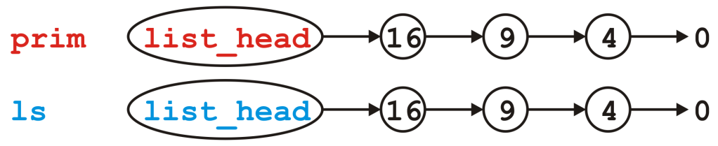
Copy
Simply copy the head of a linked list is NOT enough!
Change one of the copies will change the content of others as well
To safely copy a linked list, allocate new memory space for every node is necessary.

Slide 14
Examples
Stage1: Implement all methods in main function
Work but messy
Stage2: Abstract methods as functions
Better
Stage2.5: Use Node ** to transfer head pointer
Avoid risks to forget changing head (especially when insert/pop front)
Stage3: Abstract the Linked list as a struct
A slight smell of OOP?
Thinking: What if we need linked list for different data types?
Possible approaches: union/void*/Macro/template(C++)

Slide 15
Introduction to OOP
Take Linked List as example

Slide 16
Create a Linked List Class
The Linked List can be an object
Our Linked List provides functions to react with itself. The user doesn’t need to care about the implement of functions (Abstract).
Why we need a class
Different linked list share the same pieces of code to react with the list. A class can hold member functions, which making the code much clear.
Initialize and release is necessary for Linked Lists. A class in C++ has constructor and deconstructor, which helps coder manage there object.
Users are not suppose to access some variables. A class in C++ can prevent user to access some variables and functions.
We may want to redefine some operators (e.g. +,-,*,/,=). In C++, you can overload an operator.
Example: linked_list_C++.cpp

Slide 17
Evolution!
Reference VS Pointers
(Left Value) Reference works just like pointers, but they are much friendly to your eyes.
Templates Save TIME
Template allow coders to use a function with different input datatype.
Why reference is useful?
It saves time when tranfering paraments between caller and callee.(Especially when dealling with huge object).
Operator Overload
Allow you to change behavior of operators
Example: linked_list_template.cpp

